Slide 1
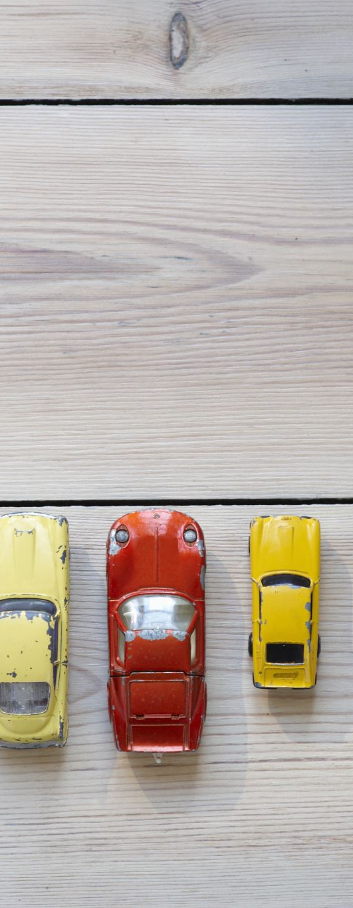
Used Vehicle Market Analysis In Albuquerque
Insights for Sales, Marketing & Inventory Strategy
Shahtab Amir| 09/22/2025

Slide 2

The Problem
We will analyze the Albuquerque used-vehicle Craigslist market data to guide marketing and inventory decisions.
Main challenge: Identify which vehicles sell at the high vs low ends of the price range, and what characteristics define them.

Slide 3
Preface On Data Cleaning
Extensive Data cleaning was required due to critical missing or incorrect information (e.g price,miles, etc), and duplicates of the same listing. This would skew the data and potentially make findings unreliable or inaccurate. The goal is to generate actionable insights built on a solid base of data.
Fields outside of realistic price or mileage were dropped
Manufacturers and other fields were filled in if the model was clearly identified

Slide 4
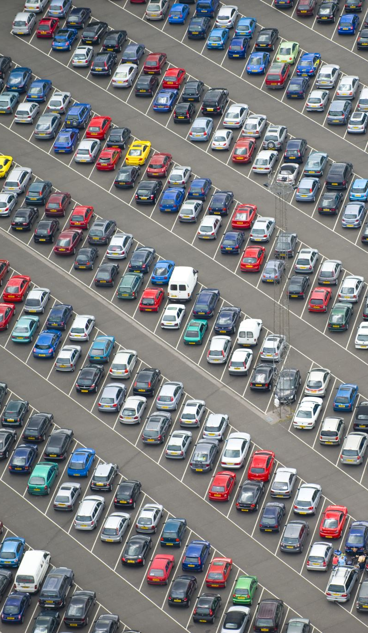
Key Questions
• What kinds of vehicles are being sold in Albuquerque?
• What characteristics are common in high-priced vs low-priced vehicles?
• Which manufacturers and models are most popular?
• How do condition, mileage, year, and fuel type affect pricing?

Slide 5
What Kind of Vehicles are Sold locally?
• ~2,900 original records, reduced to ~2,300 after cleaning
Necessary to provide accurate analysis
• Fields: manufacturer, model, year, condition, odometer, price, fuel, drive, type, etc.
• Data Types: categorical (make, condition, fuel), numerical (price, odometer, year)
Key Statistics:
• Price range: $500 – $163,540 (avg $22,665)
• Odometer range: 0 – 492,000 miles (avg ~79,700)
• Year range: 1980 – 2021 (avg 2013)

Slide 6
What do the Numbers Say?
odometer |  |  | year |  |  | price
Mean | 79,707 |  | Mean | 2013 |  | Mean | 22,665
Standard Error | 1,330 |  | Standard Error | 0 |  | Standard Error | 354
Median | 65,402 |  | Median | 2015 |  | Median | 18,990
Mode | 10 |  | Mode | 2018 |  | Mode | 7,950
Standard Deviation | 63,723 |  | Standard Deviation | 7 |  | Standard Deviation | 17,018
Sample Variance | 4,060,640,974 |  | Sample Variance | 52 |  | Sample Variance | 289,616,082
Kurtosis | 2 |  | Kurtosis | 3 |  | Kurtosis | 7
Skewness | 1 |  | Skewness | -2 |  | Skewness | 2
Range | 492,000 |  | Range | 41 |  | Range | 163,040
Minimum | - |  | Minimum | 1980 |  | Minimum | 500
Maximum | 492,000 |  | Maximum | 2021 |  | Maximum | 163,540
Sum | 182,848,549 |  | Sum | 4641112 |  | Sum | 52,265,298
Count | 2,294 |  | Count | 2306 |  | Count | 2,306

Slide 7
Top 10 Manufacturers
Which Brands are Most Common?

Slide 8
Visualization – Top 10 Models
Column chart lists the most common vehicle models.
Focus should be placed on acquiring these models as the are the most popular
Targeted Advertisement for Truck Owners and Sedan buyers to maximize market share

Slide 9
High vs Low Price Models
Trucks and the Rubicon are the high-end market in the area. Focus advertisement efforts on these buyers by offering promotions on these vehicles
The F-150, Ram 1500 hold strong across all price segments so advertising these models will attract both segments of market
For first time or value shoppers focus on the reliable sedans (Accord, Civic, Camry, Altima)

Slide 10
Target 2017 for vehicles in the High Segment, most buyers are ok more than a few years old (it may not be necessary to pay more for newer model to attract most buyers)
Low Segment shoppers are ok with models as old as 2002 so acquire as much as you can for popular models even if they are much older
The trend has spikes in years prior to 1997 due to unique or rare vehicles but generally price rises for newer model years (it does not mean they are the most common)

Slide 11
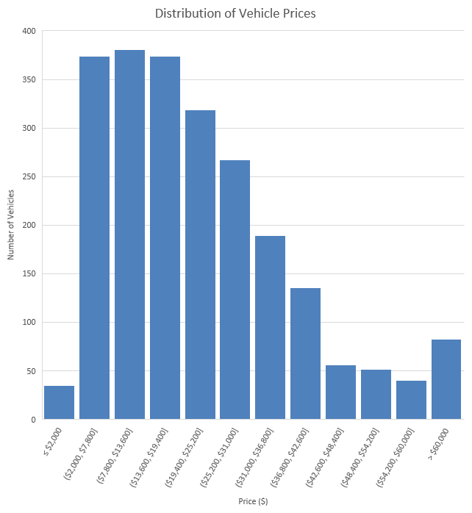
Price Distribution
Histogram showing clustering of vehicles in the $10k–$20k range.
Bin | Frequency
$31,000 | 586
$13,600 | 381
$7,800 | 374
$19,400 | 374
$36,800 | 189
$42,600 | 136
$252,001 | 83
$48,400 | 56
$54,200 | 52
$60,000 | 40
$2,000 | 35

Slide 12
Fuel Type Distribution
Fuel type is predominately gas but an interesting finding is that is a noticeable market for high end Diesel Trucks. Target these shoppers through campaigns to capture this segment

Slide 13
Visualization – Price by Condition
Surprisingly good vehicles are the most common in the high end segment. Acquire premium vehicles that may not be like new or excellent.
Shoppers in the low segment may place a premium on quality as salvage, fair conditions are not as common. Ensure messaging relays reliability and emphasize reconditioning and brand commitment to quality.

Slide 14
Final Analysis
• High-end vehicles: newer (avg 2017), low mileage (~45k), trucks/SUVs (Ram, Jeep, Silverado)
• Low-end vehicles: older (avg 2002), higher mileage (~154k), sedans (Accord, Camry, Outback)
• Condition: 'Good' is standard across both segments
• Fuel: Gas dominates overall; diesel matters in premium trucks

Slide 15
Recommendations
• High-end buyers: Focus on newer, low-mile trucks/SUVs; market diesel capability
• Low-end buyers: Emphasize reliability/condition of sedans; highlight value
• Acquisition strategy: Prioritize off-lease vehicles in 'good' condition
• Marketing strategy: Segment campaigns for value vs premium shoppers

Slide 16
Next Steps
• Collect more detailed data (trim levels, accident history, geographic sub-markets)
• Track sales conversion (not just listings) for better targeting
• Explore seasonal patterns using posting_date
• Expand analysis to regional comparisons beyond Albuquerque

